Slide 1
House Hold Prediction
Using Linear Regression
Name : Abdul Haseeb Arif
Reg no. : 2023-BS-AI-033

Slide 2
Introduction
Objective: Predict house prices using regression modeling.
Purpose: Accurate housing price prediction helps buyers, sellers, and real estate professionals make informed decisions.
Approach: Use a dataset with various housing features and build a regression model to predict price.

Slide 3

Dataset Overview
Rows: 1,000
Columns: 8
Features:Square_Footage, Num_Bedrooms, Num_BathroomsYear_Built, Lot_Size, Garage_SizeNeighborhood_Quality
Source : Kaggle (House_Hold Prediction Dataset)

Slide 4
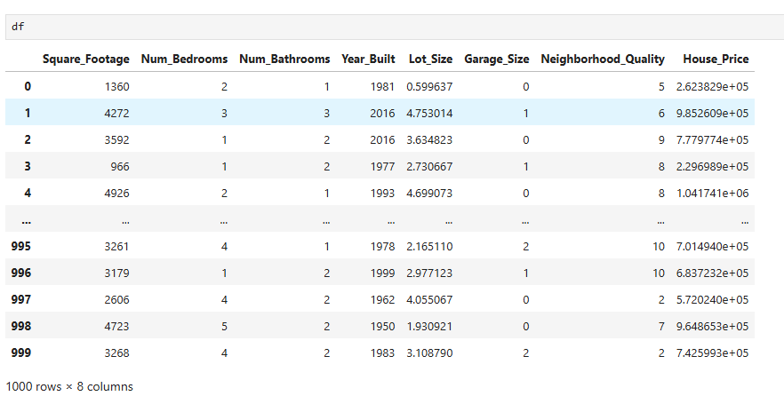
Exploring the dataset
An overview of rows and coloumns

Slide 5
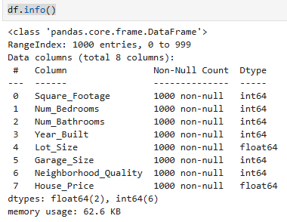
Exploring the dataset
A short summary of the Dataset

Slide 6
Preprocessing Steps
Handled Missing Values
Checked for null values in all columns using df.isnull().sum()
No missing data was found in the dataset

Slide 7

Preprocessing Steps
Standardized Data
Applied feature scaling
Ensured features are on the same scale to improve model performance

Slide 8
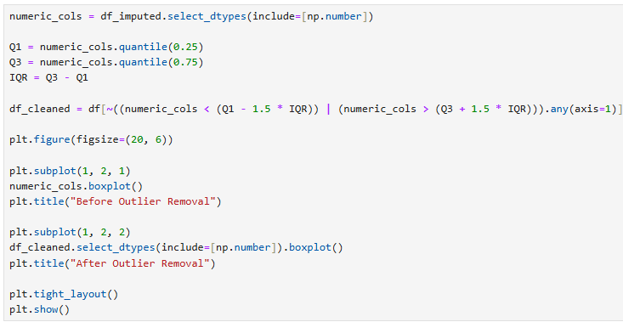
Preprocessing Steps
Removed Outliers
Detected outliers using techniques such as:
Z-score method or Interquartile Range (IQR)
Removed or capped extreme values that could skew the model

Slide 9
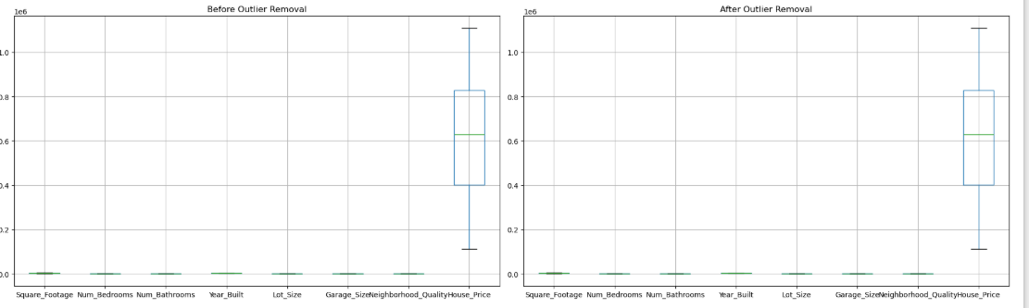
Preprocessing Steps

Slide 10
Preprocessing Steps
Train-Test Split
Divided the dataset into:
Training Set: 80% of the data
Testing Set: 20% of the data
Used train_test_split() from sklearn.model_selection

Slide 11

Modeling
Linear Regression: A simple model that predicts house prices by fitting a straight line through the relationship between features and the target variable

Slide 12
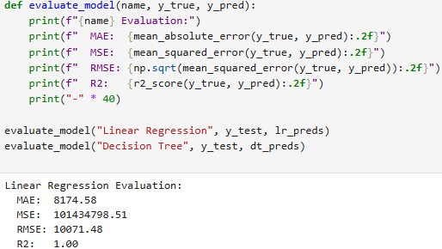
Evaluation
Metric: R² Score, MAE, MSE, RMSE
Example Results:R² Score: 0.87
RMSE: $55,000 (example, replace with actual from notebook)
Interpretation: Model explains 87% of the variance in house prices.

Slide 13

Modeling
Decision Tree Regression: A non-linear model that predicts house prices by learning decision rules from the data and splitting it into regions based on feature values.

Slide 14
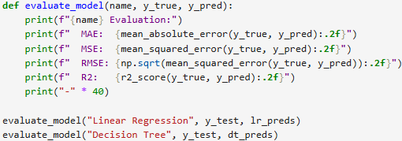

Evaluation
Metric: R² Score, MAE, MSE, RMSE
Example Results:R² Score: 0.87
RMSE: $55,000 (example, replace with actual from notebook)
Interpretation: Model explains 87% of the variance in house prices

Slide 15
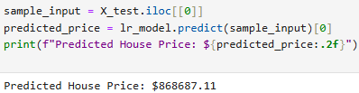
Final Output
The Final output predicted by the most accurate model Linear Regression

Slide 16
Key Findings
Most impactful features: Square footage, neighborhood quality, and lot size.
Homes with larger square footage and higher neighborhood quality tend to have significantly higher prices.
Garage size and number of bathrooms had smaller influence.

Slide 17
Conclusion
Successfully built and evaluated a regression model.
The model performs well and can be used for price estimation.
Future improvements could include more complex models or additional features like location data.

